Slide 1
Afiapharma
Fast procurement: 3-hour delivery, flexible credit

Slide 2
Problem
Fragmented supply chains and Inefficient procurement :
In Africa lead to high costs, shortages, and limited access to essential medical supplies, severely impacting patient care.
For instance, in Rwanda, only 8 dialysis centers serve over 520,000 individuals affected by chronic Kidney disease, representing 4% of the population

Slide 3
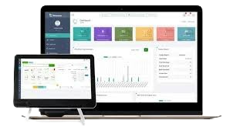
Solution
Afiapharma is a pharma procurement platform for pharmacies, hospitals, and dialysis centers, offering easy sourcing, collateral-free inventory loans, and 3-hours last-mile delivery.

Slide 4
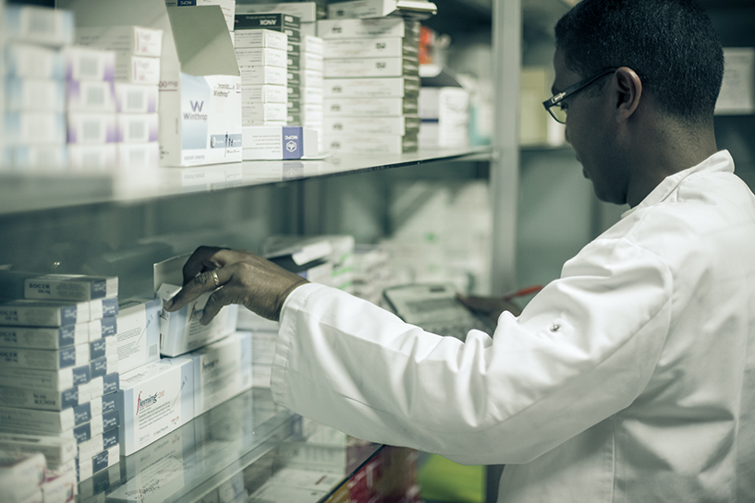
Value Proposition
Central purchasing hub with 2000+ pharmaceutical Products
3 hours Fast Delivery Service
Collatera-free inventory loans
Ensure timely access to essential medical supplies within 3 hour
Stress-free inventory financing option that allows you to stock up first and pay later after dispensing to patients
Digital marketplace– Rare medication, specialty items, medical consumables, small medical devices - No need to visit the market with multiple sales representatives with high markup

Slide 5
Target Market
IDEAL CUSTOMER
Our ideal customers are dialysis centers, clinics, and hospitals that need to source their inventory of medical consumables and medical medications.
$ 40 B
TOTAL MARKET SIZE
The African pharmaceutical market is valued at approximately $40 billion, and is projected to reach $70 billion by 2030 .

Slide 6
Business Model
Transaction Fees
We earn revenue from direct online sales of pharmaceuticals, consumables, and medical supplies, maintaining a 30% profit margin, focusing on COGS and shipping.

Slide 7
COMPETITORS
Viebeg Medical
Drugstoc
.
$ 2,5 million in funding
4,4 million in Series A
Competitive Advantage: Our solution offers simplified procurement, ensuring faster access to dialysis consumables and medical supplies with 3 hour-delivery, and credit options .

Slide 8
Incubation Program Achievements
1. Market Analysis completed | While conducted in Q1 2024 – 15% of the $21,000 fund was invested
2. Prototype Launched | Leveraging Successfully launched in Q2 2024 – 25% of the $21,000 fund was invested
3. Consumables Warehouse Setup | Identify Established a central warehouse for dialysis and medical supplies in Q2 2024 – 30% of the $21,000 fund was invested
4. Wholesale Pharmacy License Application | Offering Applied and anticipated to obtain the license by the beginning of July 2024– 10% of the $21,000 fund was invested
5. Negotiations with Africa Healthcare Network (AHN) 6. Transaction volume : $ 316,000 in total | Offering Currently in advanced negotiation to become their supplier of dialysis consumables, negotiations are 70% complete – 20% of the $21,000 fund was invested

Slide 9
OUR FUTURE PATH
2024
2025
2026
2027
2028
Launched the prototype
Onboard 50 healthcare facilities
Achieve $ 150,000 Annual Revenue with 1,000 transactions
.
User base to 200 healthcare facilities.
5,000 transactions $1M annual revenue
Implement AI-driven inventory and demand forecasting
Seed Round $1,5 M
.*
Operate in 3 additional countries: DRC, Burundi, Zambia
Process 15,000 transactions,$3M annual revenue
Serie A of $5M
Penetrate 5 more regional markets
Serve 1,000 healthcare facilities
Achieve 30,000 transactions, $10M annual revenue
Serie B $30M
Achieve $30 M in annual revenue
IPO
Operates in 10 countries

Slide 10
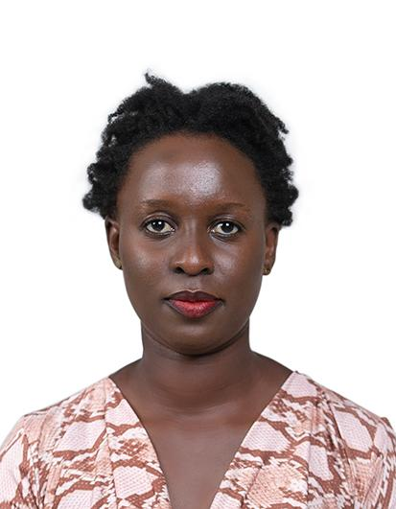
MEET THE TEAM
Biganza Papy
Gakiza Canisius
Kundwa Celine
Shakur Munyewiru
Founder & CEO
Co-Founder & CTO
Supply Chain Manager
Salesperson
9 years of experience in e-commerce.
9 years of experience in technology
9 years of experience in supply chain / Pharmacovigilance.
5 years of experience in hospitalization

Slide 11
Use of fund
20% on Product Development & Technology
35% on Initial Stock of Medical Supplies
25% on Marketing and Sales
20% on Team Expansion & Training
$ 100,000

Slide 12
Thank you.
Biganza Papy , Founder & CEO
info@afiapharma.com
+ (250) 785029694

