Slide 1
Renal Health Ambassadors (RHA) Program

Slide 2
Introduction
Name: Renal Health Ambassadors (RHA) Program
Organization – Parkers Mobile Clinic
Current Geographic area of coverage – Anambra State, Nigeria
Website - https://pmc360.org/renal-health-ambassadors/
Vision: Leading provider of comprehensive kidney health solutions in Nigeria
Target: Impact positively on the lives of over 5,000,000 individuals in the next 5 years through access to health education of renal diseases, screening and treatment services.
Disease - CHRONIC KIDNEY DISEASE

Slide 3
The Problem
Kidney disease is a severe health issue in Nigeria, affecting over 20 million people annually.
High mortality rates (About 90% of patients with Chronic Kidney Disease die within 90 days of starting dialysis), decreased quality of life, financial burden, and strain on healthcare systems.
Early detection, prevention, and comprehensive treatment can significantly reduce these adverse effects.
4. Nigeria spends over $1B on medical tourism out of which over 30% is due to kidney disease (based on our market research)

Slide 4
Our Comprehensive Solution
01
Awareness and Education:
Community campaigns, workshops, websites, and social media for kidney health education.
Preventive Measures:
Personalized guidance on diet, exercise, smoking cessation, and behavior change.
02
03
Early Detection Screenings:
Affordable screenings with portable diagnostic equipment.
04
Comprehensive Treatment
Collaborations with nephrologists, dialysis centers, and transplant centers.
Continuous Monitoring and Support:
Patient registry, digital health tools, virtual consultations, psychosocial support.
05

Slide 5
Our Unique Value
Early Detection:
Improving outcomes through timely identification.
Improved Quality of Life:
Empowering individuals to adopt healthy lifestyles.
Access to Treatment:
Collaborations with healthcare providers for personalized care.
Affordable & Accessible:
Subsidized pricing and partnerships for low-income individuals.

Slide 6
Business Model
Patient fees for screenings (2-5usd per session) and
consultations, and follow-up visits. (5-10 USD)
Insurance reimbursements for eligible services provided.
B2B partnerships with wholesale Drug vendors and pharmaceutical companies for medication discounts.
B2B partnerships with hospitals, dialysis centers for shared revenue and referral systems.(10% commission)
Note : Cost of a dialysis session - $150
Cost of kidney transplant - $20000

Slide 7
Commercial Strategy
The commercial strategy of the RHA Program focuses on sustainable growth and accessibility. Leveraging a diversified revenue model including patient fees, insurance reimbursements, and strategic partnerships with pharmaceutical companies and dialysis centers, the program ensures financial viability. Our affordable services tailored to low-income individuals aims to penetrate the market effectively. As we expand our reach to multiple states, this strategy ensures a balance between revenue generation and equitable access to quality kidney health care.

Slide 8
Target Audience
Individuals at risk of or affected by kidney disease, especially those with diabetes and hypertension.
Urban and rural communities, focusing on underserved populations with limited healthcare access.
Healthcare professionals, including nephrologists, nurses, and community health workers.
Pharmaceutical companies for medication partnerships.
Dialysis centers for collaboration and shared referral systems.
Government agencies for policy support and resource allocation

Slide 9
Scalability
The Renal Health Ambassadors (RHA) Program is inherently scalable due to its adaptable framework. Leveraging digital platforms, partnerships, and standardized protocols, the program can be efficiently replicated across regions. As demonstrated by our expansion plan from one state to four, the program's model can be easily scaled to address kidney health challenges in multiple states, ensuring a broader impact on a larger population.

Slide 10
Market Share Potential
With an annual prevalence of over 20 million kidney disease cases in Nigeria, the Renal Health Ambassadors (RHA) Program possesses the potential to capture a substantial market share. Through expanding to four additional states, the program aims to impact millions more, targeting a potential market share of over 5 million individuals. This underscores the significant demand for its comprehensive kidney health solutions, positioning the RHA Program to make a substantial positive impact on the healthcare landscape in Nigeria

Slide 11
IP PROTECTION
We are actively pursuing intellectual property (IP) protection for our innovative solutions within the Renal Health Ambassadors (RHA) Program. This involves implementing legal measures, proprietary technology safeguards, and encryption protocols to ensure the confidentiality and exclusivity of our program's distinctive features and offerings.

Slide 12
Existing customers and impact
Reached over 2200 paying users since RHA launch in 2020.
1800 direct customers served.
400 additional paying users reached through b2b partnerships with 4 Hospitals and 4 Dialysis centers.
Projected no. of paying end-users served by 2028 - 20000

Slide 13
Social Impact Metrics Measurement (KPIs)
Number of early detection screenings conducted annually
Percentage of individuals identified with early-stage kidney disease
Number of individuals receiving personalized guidance on lifestyle modifications
Percentage of individuals adopting recommended lifestyle changes
Rate of adherence to medication management programs
Number of successful kidney transplantations facilitated
Improvement in quality of life measures for patients (survey-based)
Reduction in hospitalizations related to kidney disease complications
Patient satisfaction surveys on program effectiveness and impact.

Slide 14
Social Impact on Low-Income Families
Affordable & accessible services with reduced fees
Emphasis on preventive measures and healthy lifestyle choices.
Partnerships for discounted medications and dialysis services.

Slide 15
Funding
Total Money raised before now - $25000
Revenue so far – 100000 USD.
Projected Revenue by 2028 - $300000
Current Fundraising Target: $100000
Utilization:
Expand program reach, enhance infrastructure, support awareness campaigns, subsidize services for the poor.

Slide 16
Go-to-Market (Expansion)
Our expansion plan for the Renal Health Ambassadors (RHA) Program includes a phased approach. Within the next 12 months, we aim to finalize partnerships, secure required resources, and adapt our program for scalability. Over the subsequent 24 months, we plan to launch in four new states in Nigeria, leveraging our established framework. This timeline ensures effective execution, minimal disruptions, and maximum impact on kidney health management across Nigeria.

Slide 17
Commercial and Operational Risks,
The RHA Program acknowledges potential commercial risks like variable reimbursement rates and competition, along with operational risks such as technical issues and fluctuating patient volumes. We address these concerns through market analysis, strategic partnerships, and a contingency plan. Our focus on adaptability and collaboration helps mitigate these risks, ensuring the seamless delivery of comprehensive kidney health solutions and sustained program success.

Slide 18
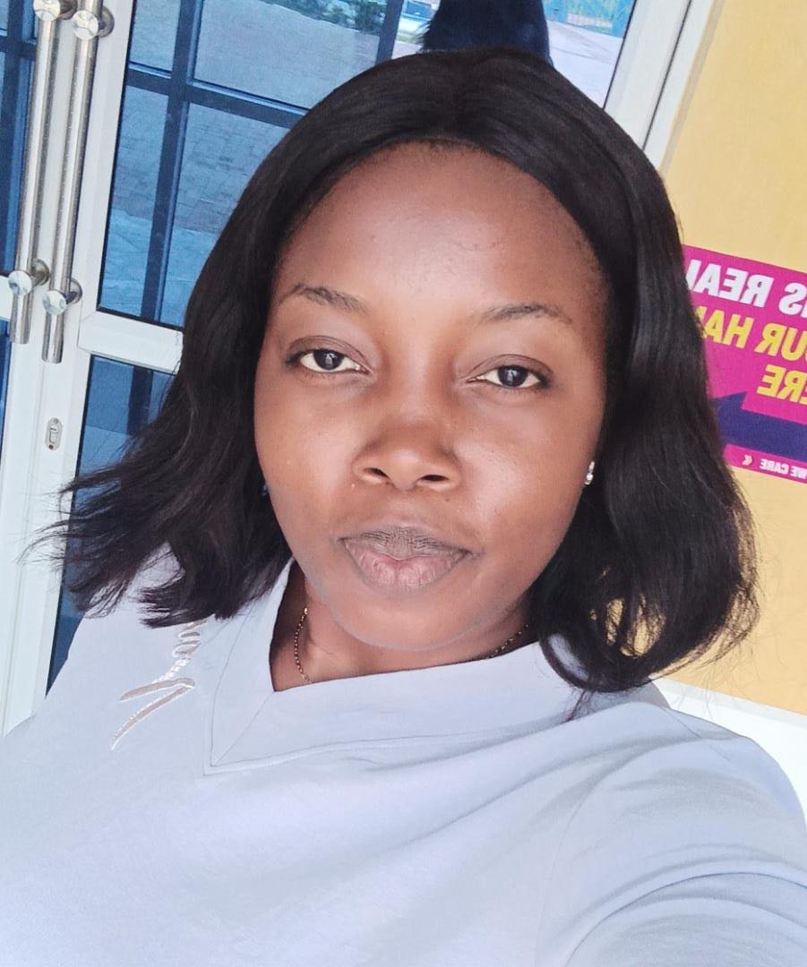
Team
Dr. Charles Umeh
CEO - Public Health Physician, Digital Health expert with 7 years experience.
won a UNDP award in 2018 and nominated for national physicians award in 2022
Maryam Bello
CTO - Healthcare Technology, 5 years experience.
Award winning STEM mentor.
Jessica Apeh
Health Program Manager - Nurse, Public Health, 4 years experience
Chidi Nwaogu
Advisor
Entrepreneurship, Business Development.
ABH finalist in 2021
Mrs. Uzochukwu Stella
Advisor
Technovation Regional Ambassador

Slide 19
Partnerships
Currently negotiating Formal partnerships with State Ministry of Health to establish referral pathways from their health centers.
01
Informal partnerships with 4 hospitals, 6 nephrologists, and 4 dialysis centers for referrals.
02

Slide 20
Our Ask
Funding: Seeking a grant of 100000 USD for further digitalization of solution and scaling solution to 4 additional states in Nigeria.
Technical Expertise: 6 months of hands-on support
Knowledge Access: Workshops & seminars on operations, systems change, social finance, etc.
Strategic Networks: Join a community of ecosystem actors and investors.
Future Support: Potential enrollment in future health hubs, accelerator and future investment cohorts.

Slide 21
Conclusion
RHA Program aims to revolutionize kidney health management in Nigeria.
Together, we can positively impact millions of lives and create systemic change.
Join us in the journey to create a healthier Nigeria!

Slide 22
AWARDS AND RECOGNITIONS
 | 2019 | OPENIDEO Healthy Bone Challenge
 | 2019 | The Goethe INSTITUTE and Ayada Lab Grant
 | 2020 | Commonwealth Youth Council Covid 19 Grant
 | 2020 | SFAN GLOBAL Student Entrepreneur of the Year Award
 | 2020 | Scottish institute of Enterprise Fresh Ideas Competition
 | 2021 | Edinburgh University Student Enterprise Initiative Grant
 | 2022 | BMJ Innovation Publication – Link
 | 2022 | Feature in USAID funded Knowledge Success Gateway Website – Link
 | 2022 | Active Citizens Award Finalist – Healthcare Category
 | 2022 | We Together Prize Finalist

Slide 23
THANK YOU

